Slide 1

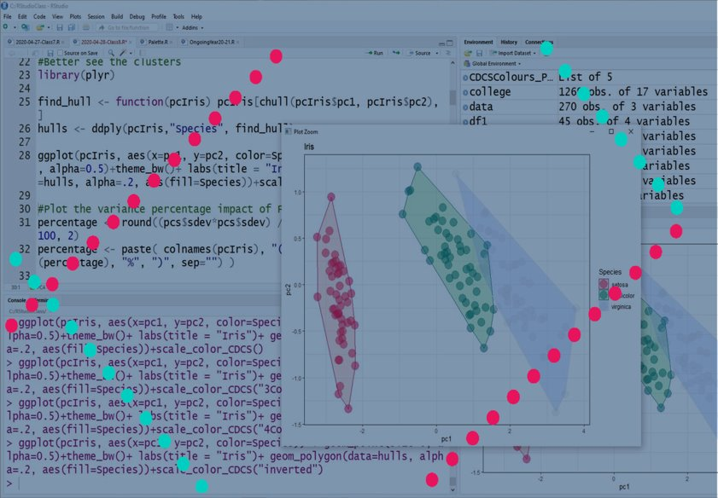
Basic Statistics and Visualisation with R
lucia.michielin@ed.ac.uk

Slide 2

Feedback
This series of trainings depend on annually allocated funds!!! To secure them we need to provide detailed feedback on them
https://edin.ac/33TwJxY

Slide 3
Today Program
Stacked Bars graphs
Cleaning Sample
Order Results
Changing scale axis

Slide 4

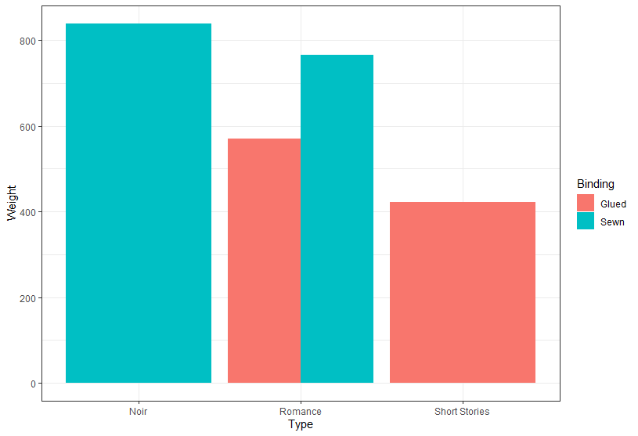

Grouped, stacked and percent stacked barcharts
Bar charts are graph that present categorical data with bars with heights or lengths proportional to the values that they represent.
The bars can be plotted vertically or horizontally
Variables Needed
1 or 2 categotical variables for x and color
Y axis
Continuous variable
Use count of a Categorical variable
www.cdcs.ed.ac.uk

Slide 5
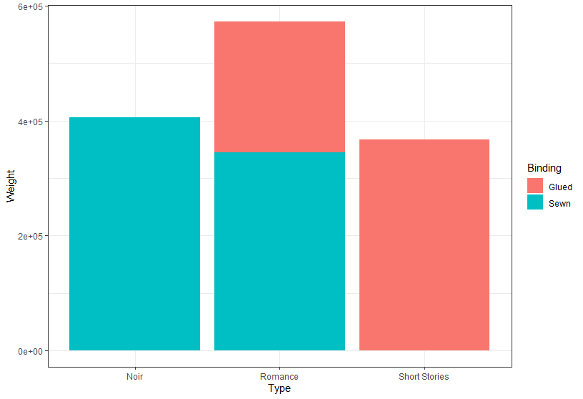
Stacked Barplot
ggplot(BooksR, aes(fill=Binding, y=Weight, x=Type)) +
geom_bar(position="Stack", stat="identity")+theme_bw()
www.cdcs.ed.ac.uk

Slide 6
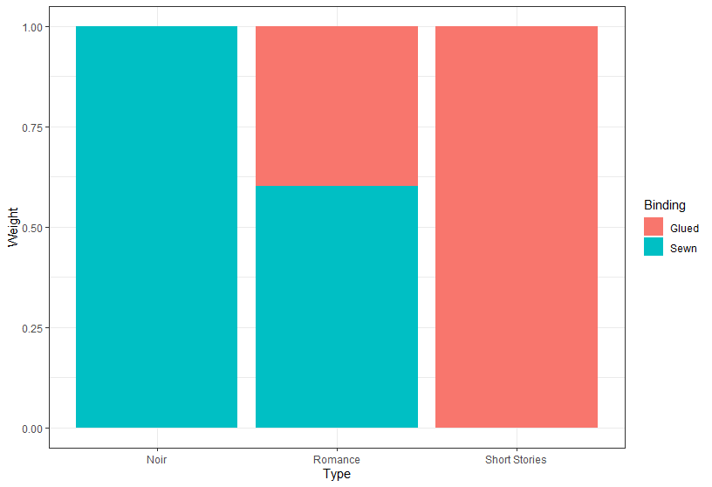
Stacked Barplot using percentage
Use the percentage of the continuous variable
ggplot(BooksR, aes(fill=Binding, y=Weight, x=Type)) +
geom_bar(position="fill", stat="identity")+theme_bw()
www.cdcs.ed.ac.uk

Slide 7
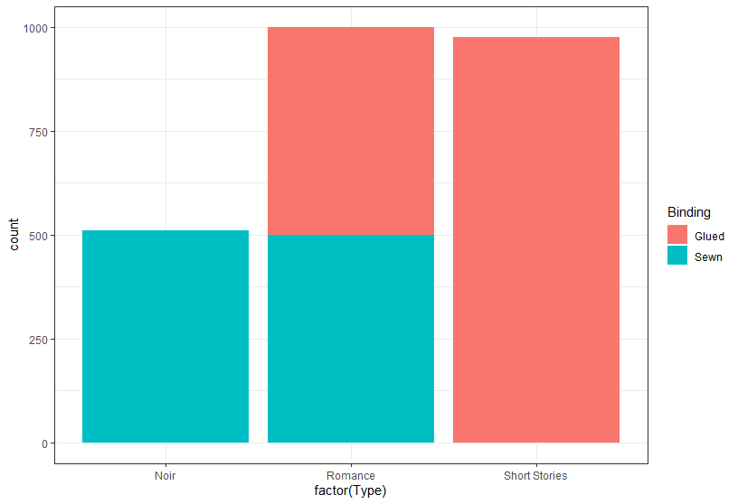
Stacked Barplot using count categorical variable
Use the count of the «Type» observations
ggplot(BooksR, aes(x=factor(Type), fill=Binding)) +
geom_bar()+theme_bw()
www.cdcs.ed.ac.uk

Slide 8
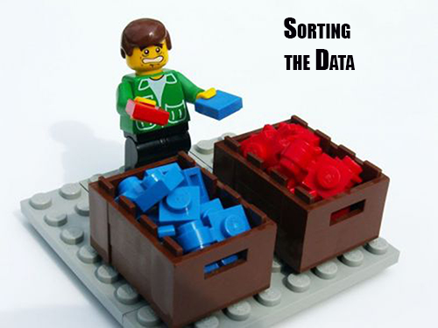
Order results
On the fly
Add to the plot
+ scale_x_discrete(limits=c("Romance", "Short Stories", "Noir"))
In the order you want them visualised
From https://blogjunkie.net/2016/01/fastmail-rules-newsletters-contact-groups/data-sorting-lego/
www.cdcs.ed.ac.uk

Slide 9
Order results
Change the dataset
From https://blogjunkie.net/2016/01/fastmail-rules-newsletters-contact-groups/data-sorting-lego/
Make sure the variable is set as factor:
newBooks <- BooksR %>% mutate(Type = as.factor(Type))
newBooks %>%
pull(Type) %>%
levels()
Define the new order
newBooks$Type <- factor(newBooks$Type, levels(newBooks$Type)[c(2,3,1)])
In the order you want them visualised
www.cdcs.ed.ac.uk

Slide 10

Correct your dataset
From https://am2.co/2019/04/code-to-purge-data-on-creation-date/
Fix a not normally distributed curve
Eliminate outliers
Remove null values
www.cdcs.ed.ac.uk

Slide 11

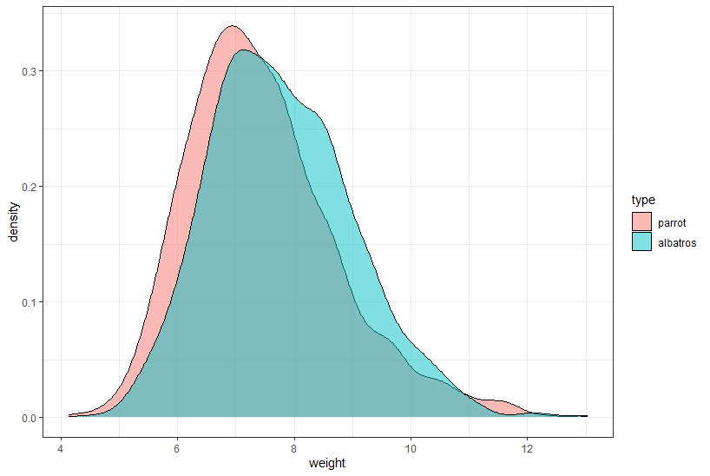
Testing
Fix a Skewed distribution
This is very normal when you deal with real word dataset how do you fix it
www.cdcs.ed.ac.uk

Slide 12
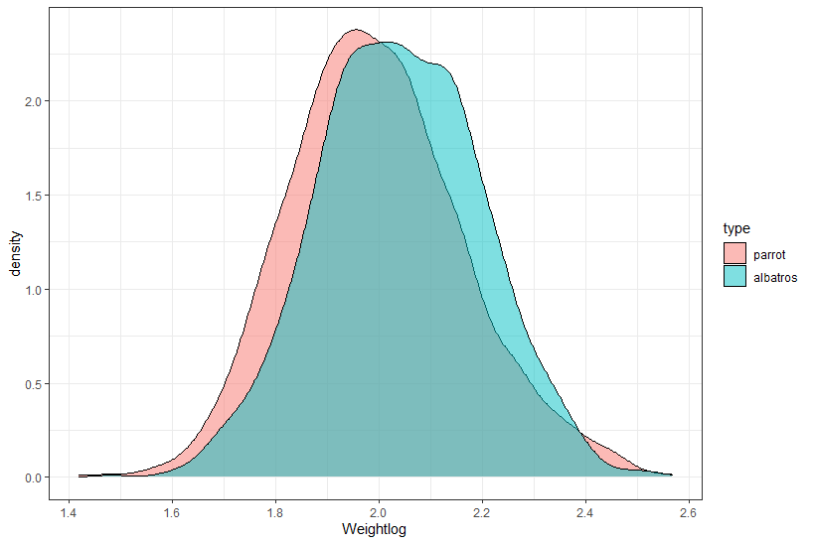
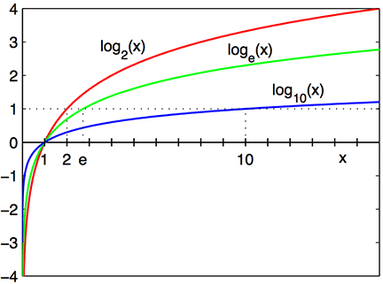
Use Log
By transforming the continuous variable into its logarithmic value you can increase the normalisation of the curve
Pull in the outliers by doing a log transformation of the continuous value
Wikipedia
www.cdcs.ed.ac.uk

Slide 13
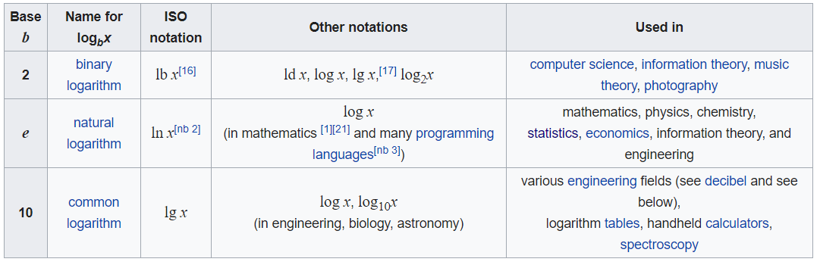
What is a log
“In mathematics, the logarithm is the inverse function to exponentiation. That means the logarithm of a given number x is the exponent to which another fixed number, the base b, must be raised, to produce that number x.”
Wikipedia
Pull in the outliers by doing a log transformation of the continuous value
e=
2.718281828459
www.cdcs.ed.ac.uk

Slide 14
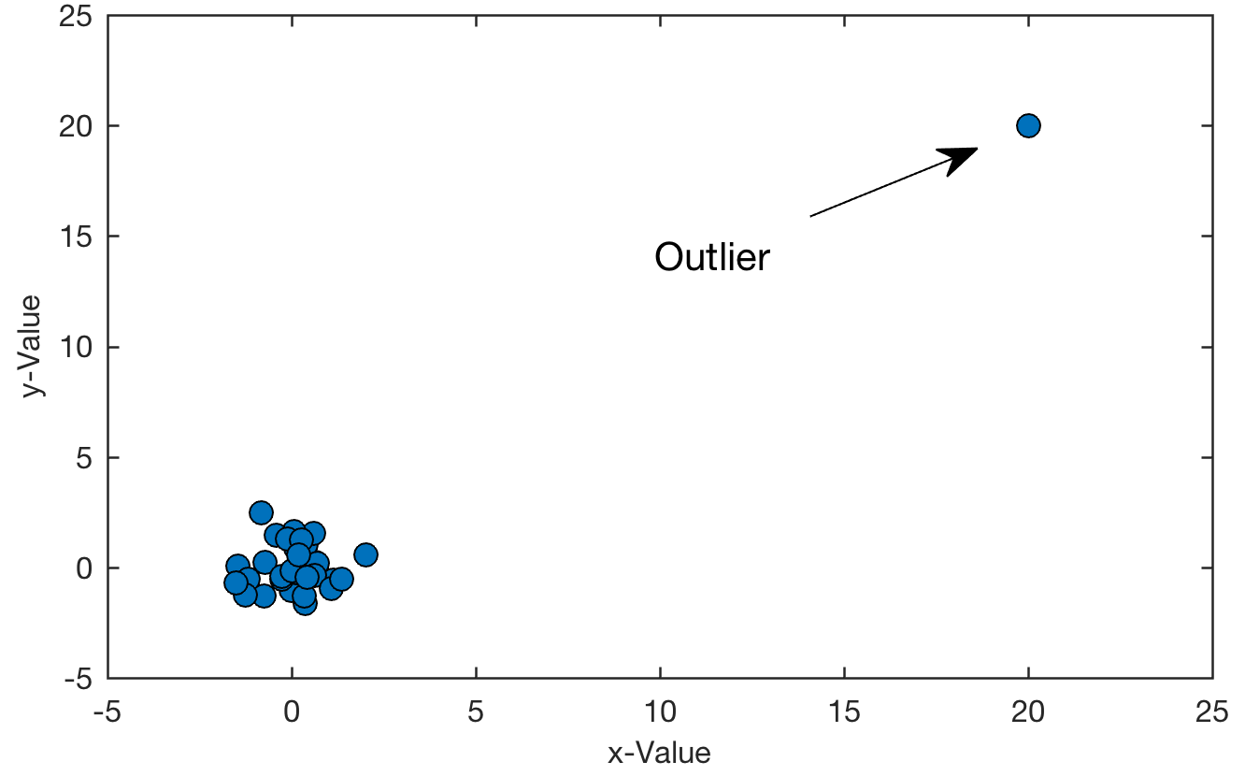
Remove outliers
Need to be done with caution and only if it is really needed
Link to full article
If the outlier is due to incorrectly entered data, you should drop it
If the outlier does not change the results but affect assumption you can drop it, but you need to acknowledge
If the outlier does effect your results you cannot drop it
If the outlier is responsible for a certain association you cannot use that sample
Pull in the outliers by doing a log transformation of the continuous value
www.cdcs.ed.ac.uk

Slide 15

Remove Null values
In order to perform any type of analysis on your sample you need to eliminate the Null values.
Two approaches possible
Eliminate all rows that has a null value for any of the variable: 1 Step analysis
Eliminate rows based on the single analysis performed: Doesn’t eliminate what is not needed but need more attention on number observations
Pull in the outliers by doing a log transformation of the continuous value
www.cdcs.ed.ac.uk

Slide 16
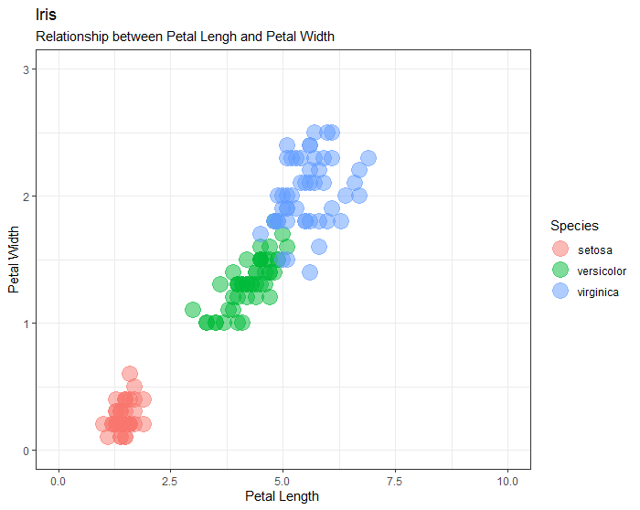
Change scale axis
Define limit axis
Add
+expand_limits(x=c(0,10), y=c(0, 3))
Pull in the outliers by doing a log transformation of the continuous value
Min and Max values
www.cdcs.ed.ac.uk

Slide 17
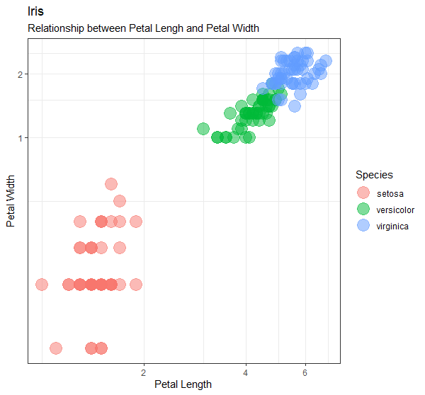
Change scale axis
Use logarithmic scale
Add
+ coord_trans(x="log", y="log")
Pull in the outliers by doing a log transformation of the continuous value
Log is natural logarithm. Also available log10 and log2
www.cdcs.ed.ac.uk

Slide 18
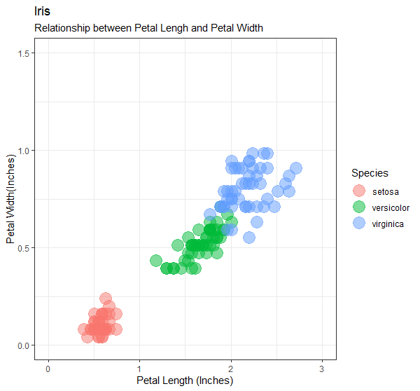
Change unit of measurment
ggplot(iris, aes(x=Petal.Length/2.54, y=Petal.Width/2.54, color=Species)) + geom_point(size=6, alpha=0.5)+theme_bw()+ labs(title = "Iris", subtitle = "Relationship between Petal Lengh and Petal Width", x = "Petal Length (Inches)", y= "Petal Width(Inches)")
Calculate a on the fly equivalence
Pull in the outliers by doing a log transformation of the continuous value
Make sure to reflect it in the legend
www.cdcs.ed.ac.uk

Slide 19
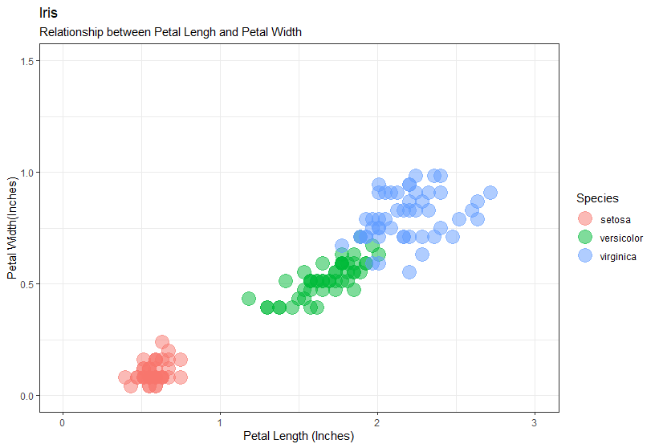
Set Thicks in the Grid
Smaller grid no visible number
Add
+ scale_x_continuous(minor_breaks = seq(0,3, 0.5),
breaks = seq(0,3,1))+
scale_y_continuous(minor_breaks = seq(0,2, 0.25), breaks = seq(0,2,0.5))
Pull in the outliers by doing a log transformation of the continuous value
Major grid visible number
Seq(start, max, every how many)
www.cdcs.ed.ac.uk

Slide 20

Any Question?
www.cdcs.ed.ac.uk

Slide 21
Challenge 6
We want to check the relationship between weight and sex but the sample need some cleaning
Remove the null values but only for sex and weight
Print a graph of the cleaned dataset that will show the difference in weight across male and female as boxplots
The two subsets (male and female) are both right skewed. Use the log transformation to remove the issue and then replot both a density graph and a boxplot
Replot the boxplot that will print the male results first and then the female
Do 2 t-tests one that will test the weight against the sex and one the weight log against the sex. Are the result different?
Pull in the outliers by doing a log transformation of the continuous value
www.cdcs.ed.ac.uk

Slide 22
Next Class
PCA
Clustering analysis

Slide 23
References
Stacked Bar Graphs
https://www.r-graph-gallery.com/barplot.html
http://www.sthda.com/english/wiki/ggplot2-barplots-quick-start-guide-r-software-and-data-visualization
https://ggplot2.tidyverse.org/reference/geom_bar.html
https://www.r-bloggers.com/make-a-bar-plot-with-ggplot/
https://www.r-bloggers.com/detailed-guide-to-the-bar-chart-in-r-with-ggplot/
https://www.linkedin.com/learning/data-visualization-in-r-with-ggplot2/bars-and-columns?autoplay=true&u=50251009
https://www.linkedin.com/learning/r-statistics-essential-training/creating-bar-charts-for-categorical-variables?autoplay=true&u=50251009
Setting Axis and Unit of measures
http://www.sthda.com/english/wiki/ggplot2-axis-scales-and-transformations
https://www.datanovia.com/en/blog/ggplot-axis-limits-and-scales/
https://rstudio-pubs-static.s3.amazonaws.com/3364_d1a578f521174152b46b19d0c83cbe7e.html
http://www.sthda.com/english/wiki/ggplot2-axis-ticks-a-guide-to-customize-tick-marks-and-labels
http://www.cookbook-r.com/Graphs/Axes_(ggplot2)/
http://r-statistics.co/Complete-Ggplot2-Tutorial-Part2-Customizing-Theme-With-R-Code.html
https://www.linkedin.com/learning/data-visualization-in-r-with-ggplot2/working-with-axes?autoplay=true&u=50251009
https://www.linkedin.com/learning/data-visualization-in-r-with-ggplot2/changing-scales?autoplay=true&u=50251009
Setting Labels and Legends
http://r-statistics.co/Complete-Ggplot2-Tutorial-Part2-Customizing-Theme-With-R-Code.html
http://www.cookbook-r.com/Graphs/Legends_(ggplot2)/
http://www.sthda.com/english/wiki/ggplot2-title-main-axis-and-legend-titles
https://www.datanovia.com/en/blog/ggplot-legend-title-position-and-labels/
https://www.linkedin.com/learning/data-visualization-in-r-with-ggplot2/cleaning-up-legends?autoplay=true&u=50251009
Order results
https://www.r-graph-gallery.com/267-reorder-a-variable-in-ggplot2.html
https://stackoverflow.com/questions/3744178/ggplot2-sorting-a-plot
https://kohske.wordpress.com/2010/12/29/faq-how-to-order-the-factor-variables-in-ggplot2/
https://sebastiansauer.github.io/ordering-bars/
Correct your dataset Outliers and Skewed distribution
https://www.linkedin.com/learning/r-statistics-essential-training/transforming-variables?autoplay=true&u=50251009
Deal with Null values
https://www.statmethods.net/input/missingdata.html
https://uc-r.github.io/missing_values
https://stats.idre.ucla.edu/r/faq/how-does-r-handle-missing-values/

